Slide 1

Canteen Management System
By
Swapan Kumar Shee
(B.Tech 2nd Year, Enrollment No.: 12021002001009 )
Shivam Kumar Mishra
(B.Tech 2nd Year, Enrollment No.: 12021002001042 )
Under the Supervision of
Prof. Jyoti Khandelwal
Dept. of Computer Science & Engineering
University of Engineering & Management, Jaipur

Slide 2
Outlines
Introduction
Introduction
Literature Review
Objectives
Proposed Model
Data Flow Diagram
Requirements
Result Analysis
Conclusion & Future Scope
Reference
Acknowledgement

Slide 3
Introduction
Canteen management system is to provide fast services to their college students, Staffs etc. Usually, People have to go to canteen and order the foods and they have to wait in queue for a long time to get the orders, But with the help of this you just have to follow a very simple process to order your stuffs. And you need not to wait in the long queue. A canteen facility is a supplementary system that is provided by organizations for their employees/students.
Organizations with large numbers of employees cannot handle a canteen with manual processes. Our canteen management system provides a friendly User Interface for numerous food outlets, menu design, billing features and lots more. Implementation of such a system makes the operation of the kitchen and the whole of the canteen as effective and quick as possible

Slide 4
Literature Review
Several research studies have explored the potential benefits of canteen management systems. One such study conducted by Gohil and Gohil (2018) [1], evaluated the impact of a computerized canteen management system in a school setting. The study found that the system improved the accuracy and speed of order processing and reduced waiting times for students.
Another study by Naveen Kumar and Veena (2018) [2], examined the implementation of a canteen management system in an engineering college. The study found that the system improved the efficiency of canteen operations and helped to reduce waste and improve inventory management.

Slide 5
Literature Review Cont.
A review article by Suresh and Balasubramanian (2019) [3], summarized the key features of canteen management systems and their potential benefits. The article highlighted the importance of integrating various functions, such as menu planning, inventory management, and payment processing, into a single system for improved efficiency.
Other studies have focused on the technical aspects of canteen management systems. For example, a study by Kaur and Singh (2019) [4], proposed a design for a wireless sensor network-based canteen management system. The proposed system utilized sensors to monitor food quality and temperature, as well as to track inventory levels.

Slide 6
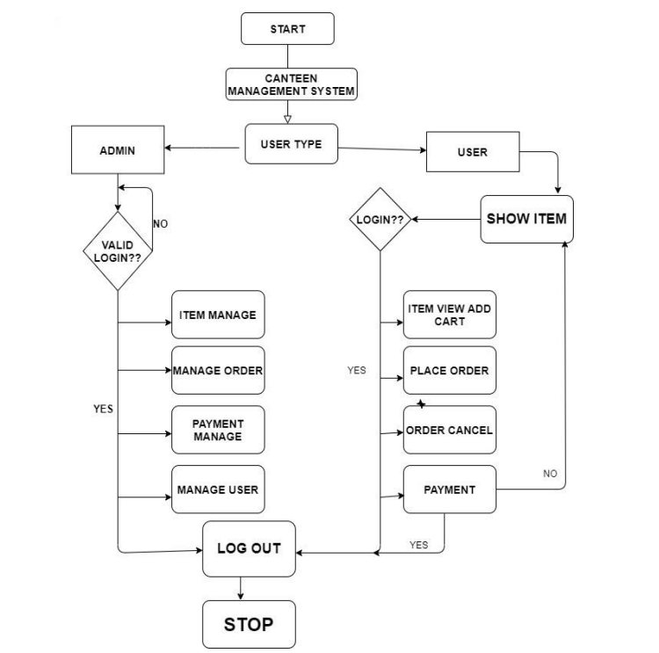
Proposed Model

Slide 7
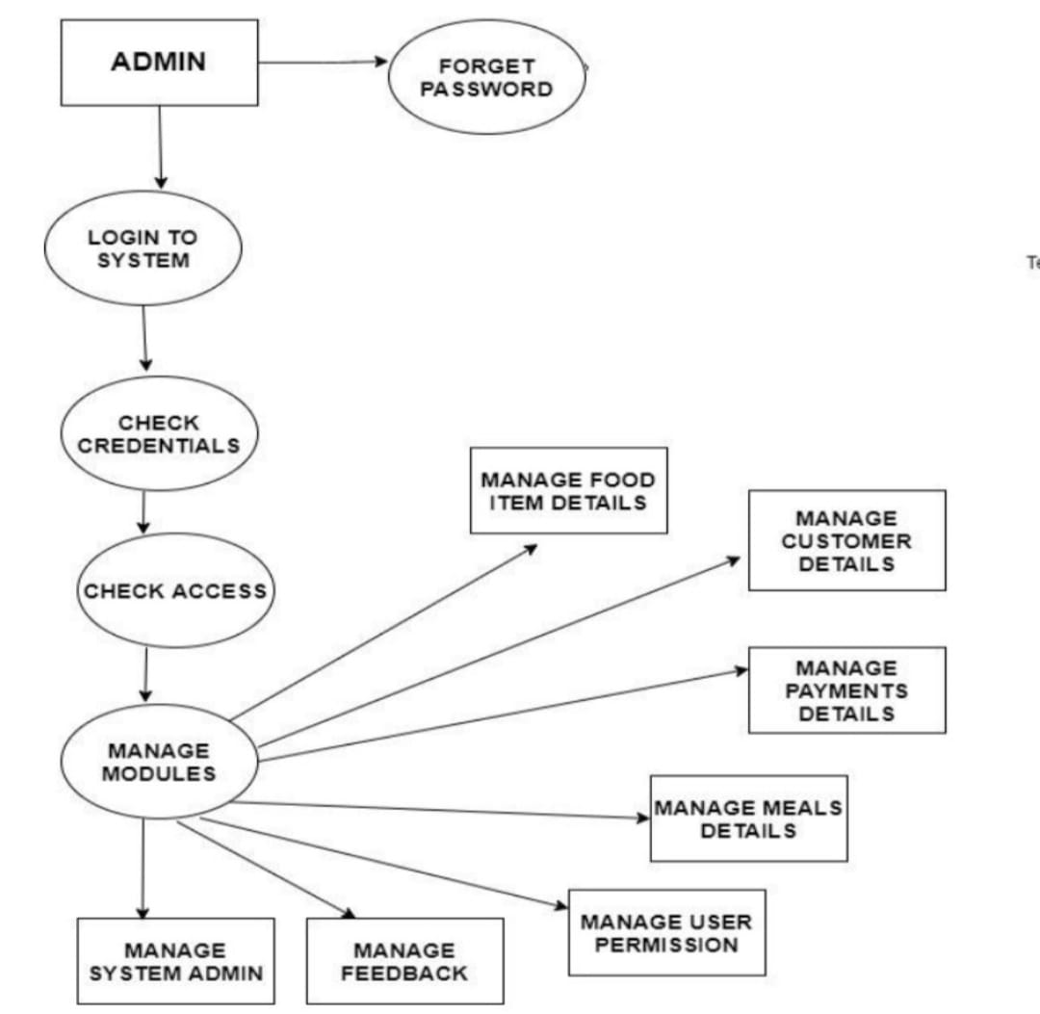
Data Flow Diagram

Slide 8
Requirements
Software Requirements | Hardware Requirements
Operating system: Windows(11) or Linux or MAC | Processor: any
Programming language: php,css | Hard disk:10 GB minimum
Editor and compiler(IDE): Visual studio code(1.76.0) or sublime text(4126) etc. | RAM:256 MB or more
Database: MySQL | Any screen
Web browser: Google chrome or Brave or Firefox etc.

Slide 9
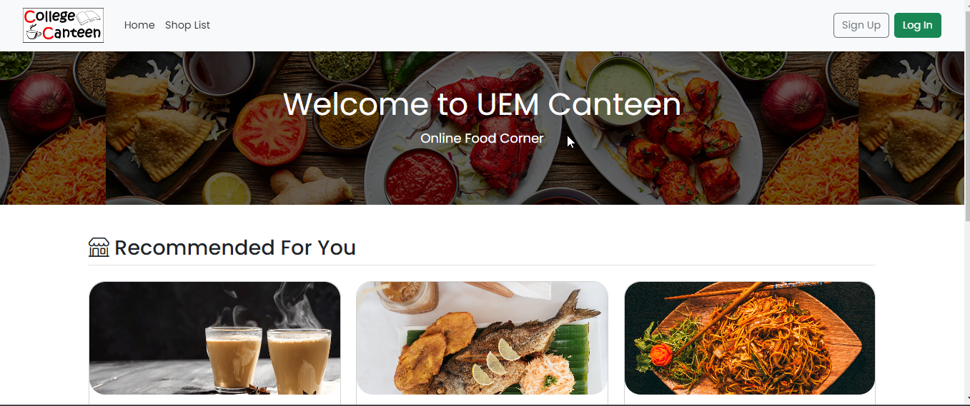
Result:
Fig.1. Home Interface

Slide 10
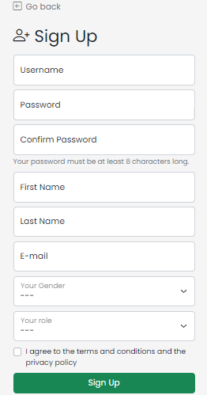
Result cont.…..
Fig .2 Sign Up page

Slide 11
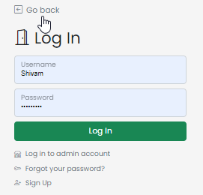
Result cont.….
Fig.3 Log In Page

Slide 12
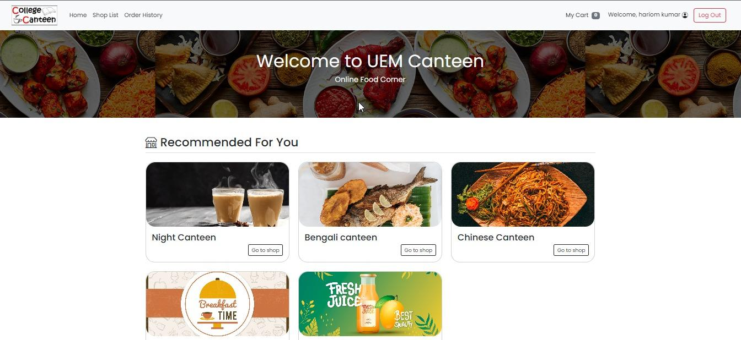
Result: cont.….
Fig.4 User Dashboard

Slide 13
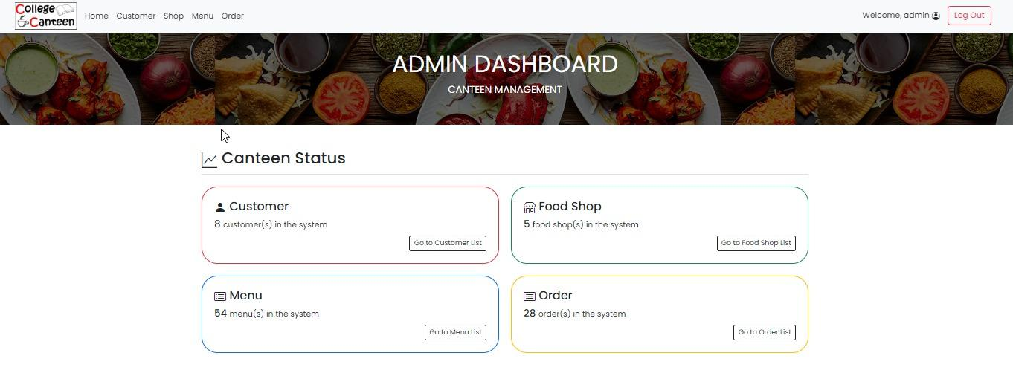
Result: cont.….
Fig .5 Admin Dashboard

Slide 14
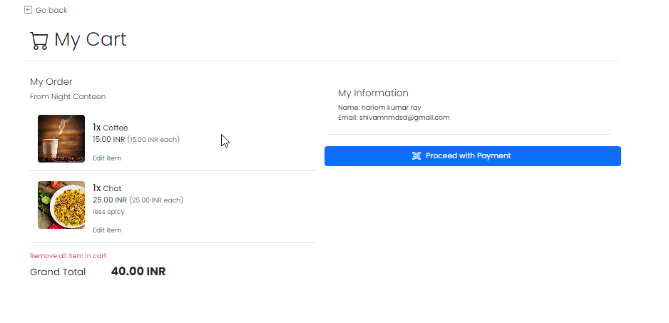
Result cont.….
Fig.6 My Cart Page

Slide 15
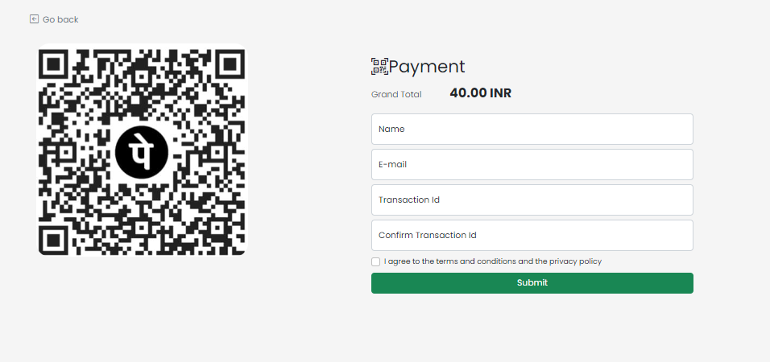
Result cont.….
Fig.7 Check Out Page

Slide 16
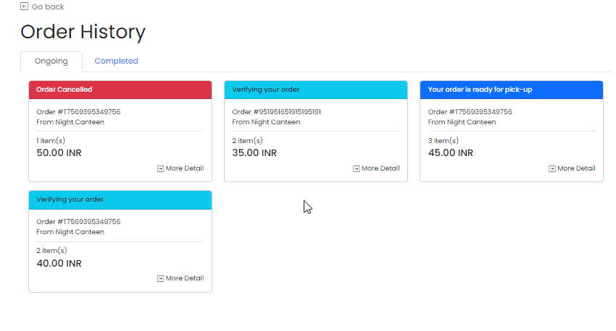
Result cont.….
Fig.8 Order History Page

Slide 17
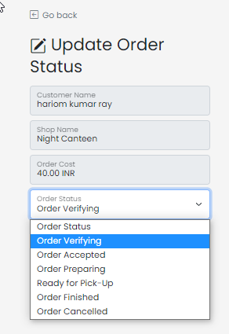
Result cont.….
Fig.9 Order Updation By Admin

Slide 18
Result Analysis
Customers Can See All The Canteens And Their Menu Details In The Canteen Management System.
Customers Can Order The Foods According To Their Requirements.
Customers Can Pay The Bills With The UPI Id And For Verification They Can Submit All The Transaction Details.
In The Admin Side Admin Can Add Or Delete The Canteen And Foods According To Needs.
Admins Can Change The Order Status Of The Customers.

Slide 19
Limitation
Customers Can Not Use The Credit Card Or Debit Card Or Internet Banking Facility Through The Canteen Management System.
The Mobile OTP Verification And Email Verification Is Not Available In The Canteen Management System.
The Canteen Management System May Not Be Scalable Enough To Handle Large Volumes Of Transactions Or A High Number Of Users. This Can Limit Its Usefulness In Larger Organizations Or Campuses.
The Cost Of Implementing And Maintaining The Canteen Management System Can Be A Limitation For Organizations Or Campuses With Limited Budgets.
If The System Is Not Properly Secured, It Can Be Vulnerable To Cyber-attacks And Data Breaches. This Can Compromise The Personal Information Of Users And The Financial Information Of The Organization.

Slide 20
Conclusions & Future Scope
In conclusion, a canteen management system project can bring several benefits to organizations or campuses, such as increased efficiency, improved user experience, and better financial management. However, it is important to consider the potential limitations of the system, such as lack of scalability, dependency on technology, security risks, lack of customization, cost, and training and adoption efforts. When implemented correctly, a canteen management system can greatly enhance the overall management of a canteen, resulting in a better experience for both the organization and its users.
A mobile app can be developed to provide users with a more convenient way to access the canteen management system, allowing them to place orders and make payments from their mobile devices.
Artificial Intelligence (AI) integration: AI can be integrated into the system to provide personalized recommendations to users based on their order history and preferences.
IoT-based systems can be integrated into the canteen management system to provide real-time monitoring of food inventory and sales, allowing for better supply chain management.

Slide 21
References
[1].E-Canteen Management System based on web application | IEEE conference ... (n.d.). Retrieved April 6, 2023, from https://ieeexplore.ieee.org/abstract/document/9767984/
[2]. Cashless & Online QR Code based Canteen Management System - irjmets.com. (n.d.). RetrievedApril6,2023,fromhttps://www.irjmets.com/uploadedfiles/paper/volume3/issue_3_march_2021/6833/1628083291.pdf
[3].Ahmed, H. M. F. A., Indap, J. P., Churchill, K., & Jayawant, V. V. (n.d.). E-canteen ordering system: Food Delivery Software. International Journal of Software Computing and Testing.RetrievedApril6,2023,fromhttps://computers.journalspub.info/index.php?journal=JSCT&page=article&op=view&path%5B%5D=687
[4].Cheif, I. J. R. A. R. editor in. (2019, March 1). Cloud based Android app for College Canteen Management System. IJRAR. Retrieved April 6, 2023, from https://ijrar.org/viewfull.php?&p_id=IJRAR19H1144 .

Slide 22
Acknowledgement
The endless thanks goes to Lord Almighty for all the blessings he has showered onto me, which has enabled me to write this last note in my project work. During the period of my project, as in the rest of my life, I have been blessed by Almighty with some extraordinary people who have spun a web of support around me. Words can never be enough in expressing how grateful I am to those incredible people in my life who made this thesis possible. I would like an attempt to thank them for making my time during my project in the Institute a period I will treasure. I am deeply indebted to my research supervisor, Professor Jyoti Khandelwal me such an interesting thesis topic. Each meeting with him added in valuable aspects to the implementation and broadened my perspective. He has guided me with his invaluable suggestions, lightened up the way in my darkest times and encouraged me a lot in the academic life.

Slide 23

Dept. of CSE, University of Engineering & Management Jaipur

